Slide 1


Slide 2
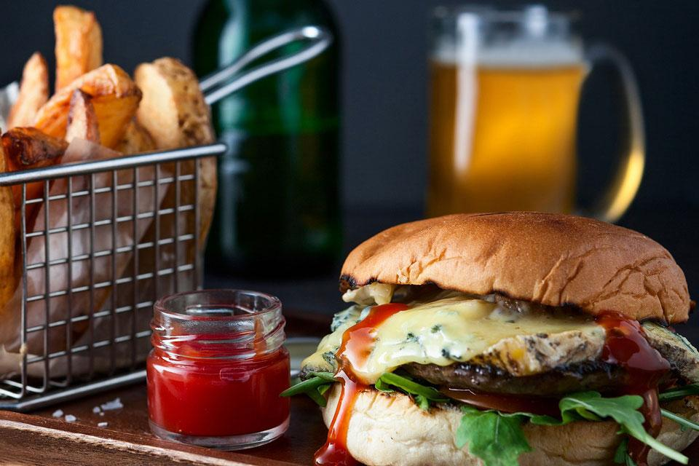
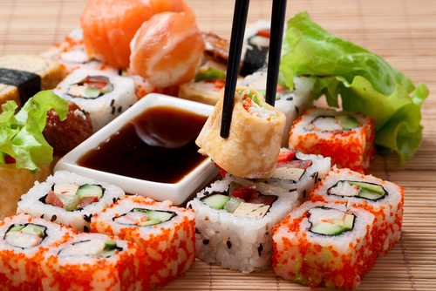
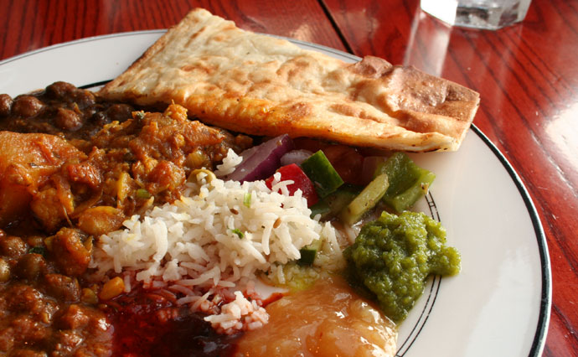
The Problem:
?
?
?
People cannot decide where to go to eat..

Slide 3
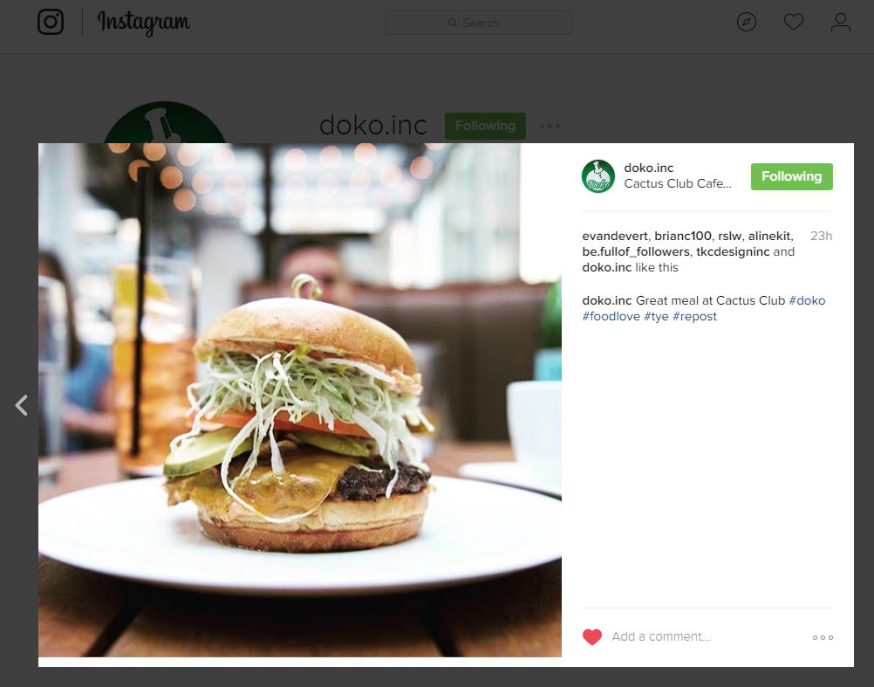
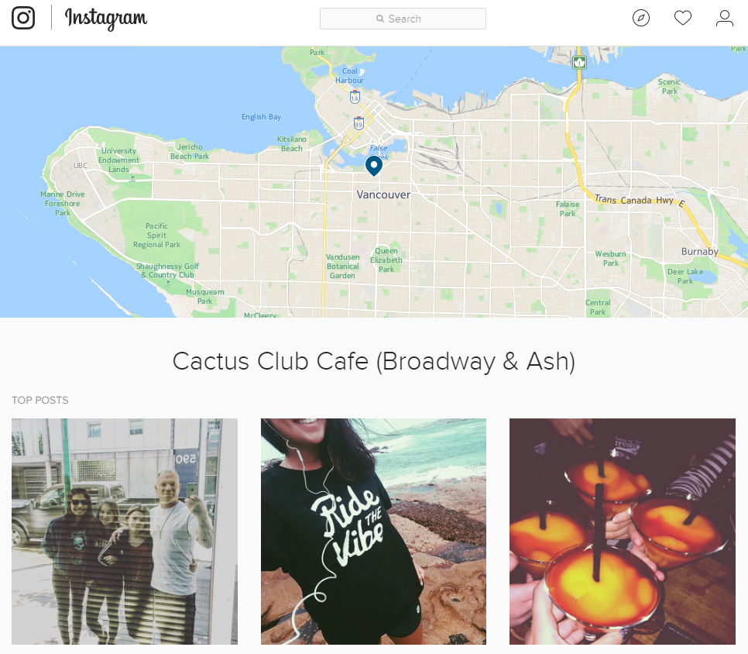
Our Solution:
Restaurant recommendations based on your:
social media presence & location

Slide 4



Slide 5

Algorithm Factors

Slide 6
Customer Validation
97.8%
use social media weekly
93.2%
want to eat at the restaurants they like photos of
88.9%
would use our app more than once a week

Slide 7
Suggestions from Survey
“Personalized restaurant suggestions based on what you've already visited.”
“Remember my preferences so when I travel and don't know the area well, the app will automatically find me places nearby that suit my tastes.”
“Integration with reservation, Snapchat, and delivery services”

Slide 8
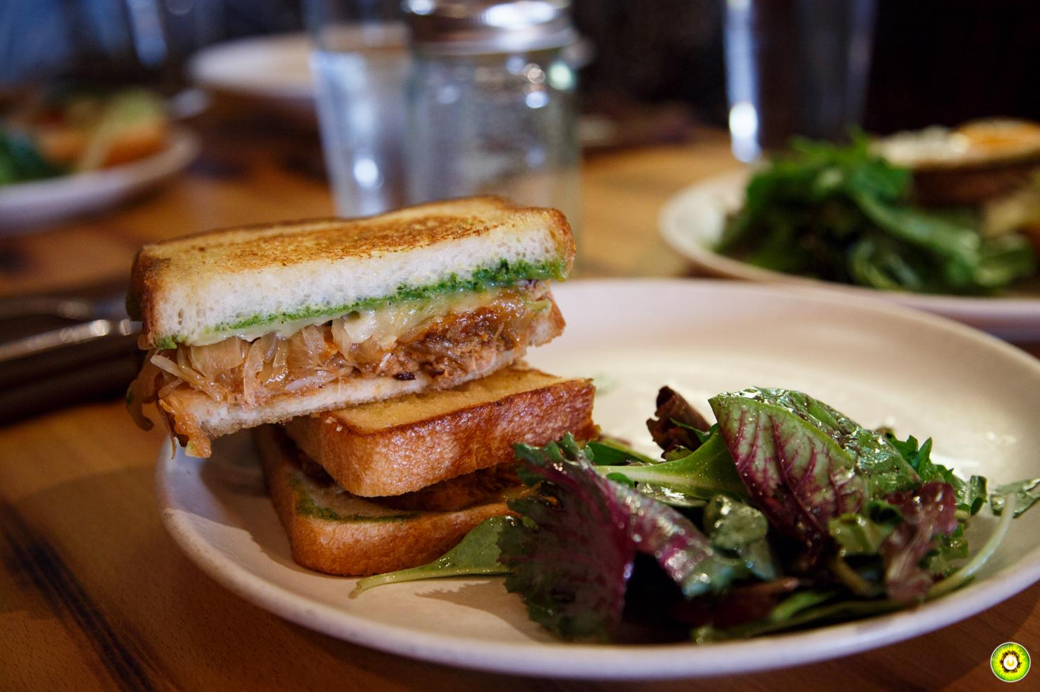
Restaurant Q&A
“Yes, our social media presence is a main channel for our customers. If half our instagram followers came to our restaurant, that would be great!”
-Mission Kitsilano
“Yes, this would be amazing.
Can you really do that?”
-Fable Kitchen

Slide 9
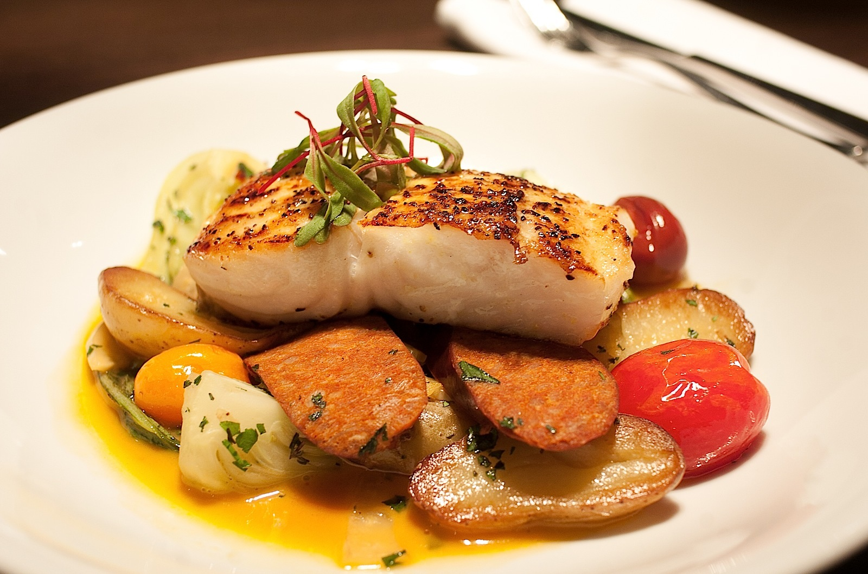
Restaurant Q&A
Yelp isn't awful, but of course not close to accurate. These are guest opinions that as a whole do not indicate how you're doing.”
“Instagram is a medium where people usually only post when they are happy which of course is much better.”
- Kathy Schleyer, Fable Kitchen

Slide 10
$3,315
Average amount an American spends annually eating out

Slide 11
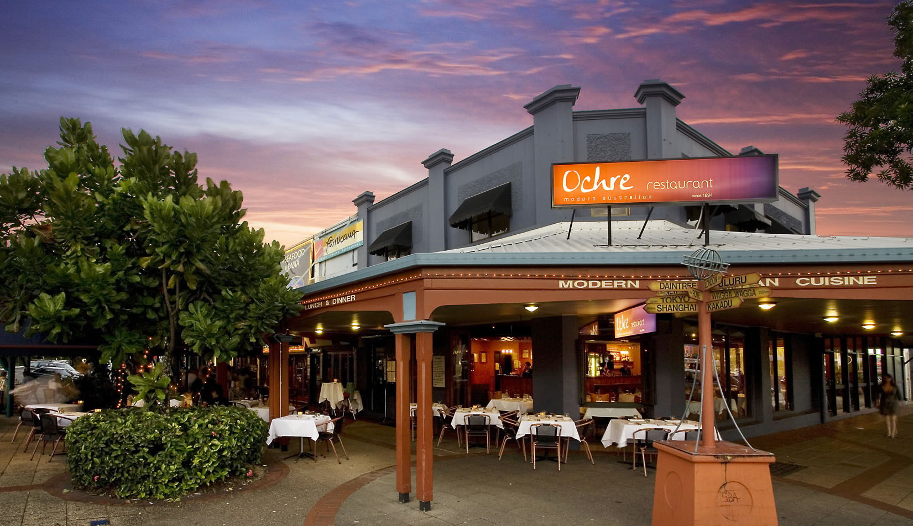

Target Markets
Existing Social Media Users
Restaurants

Slide 12
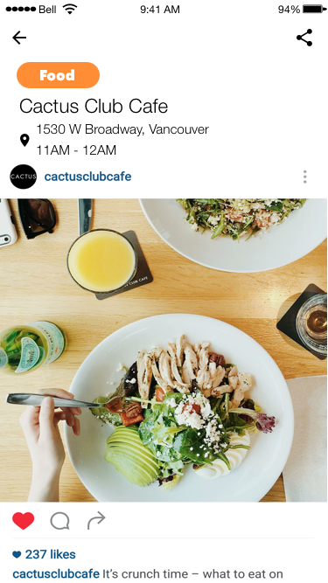
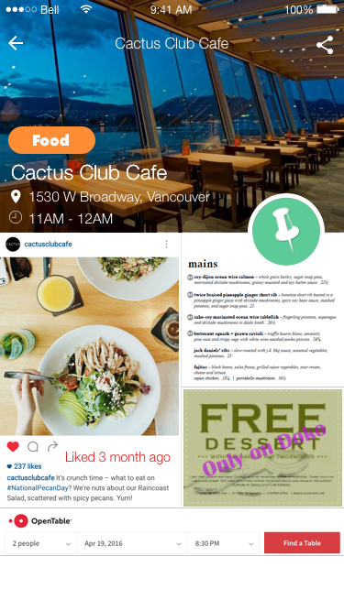
Restaurant Package
$400 up front /$50 month:
Menu
Coupon
Featured
User Data

Slide 13
Marketing Strategy
Digital Advertising
Hashtag advertisement
Instagram influencers
Featured user
Hands-on Advertising
Restaurant Stickers
Gift card giveaway
Menu-scramble
Notes:
E:
Thank you nick, Once we become public the main goal will be to expand and gain traction and to do so we have made some marketing strategies to get the word out about Doko. We have split our marketing division into two categories based on the medium of the marketing.

Slide 14
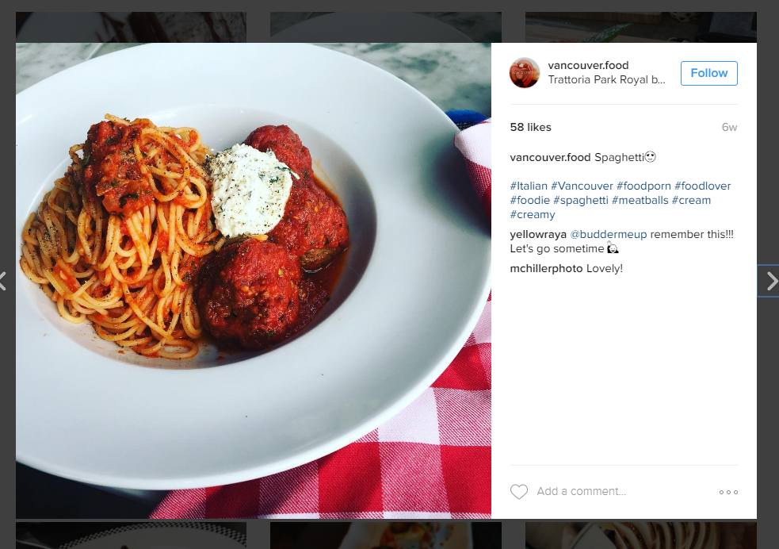
Marketing Strategy
Digital Advertising
Hashtag advertisement
Instagram influencers
Featured user
Hands-on Advertising
Restaurant Stickers
Gift card giveaway
Menu-scramble

Slide 15
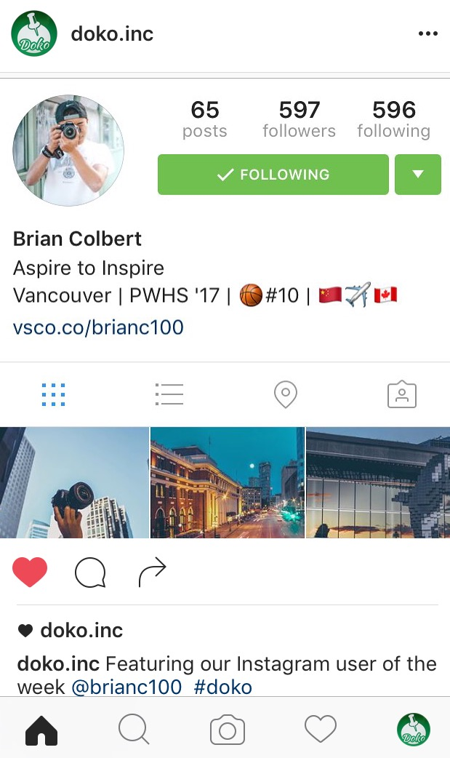
Marketing Strategy
Digital Advertising
Hashtag advertisement
Instagram influencers
Featured user
Hands-on Advertising
Restaurant Stickers
Gift card giveaway
Menu-scramble

Slide 16
Marketing Strategy
Digital Advertising
Hashtag advertisement
Instagram influencers
Featured user
Hands-on Advertising
Restaurant Stickers
Gift card giveaway
Menu-scramble

Slide 17


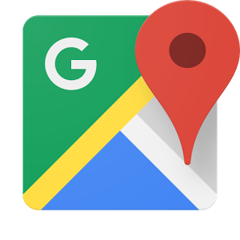

Competition Analysis
Personalized suggestions based on likes
No integration with social media
Complete integration with social media
Generalized Suggestions

Slide 18
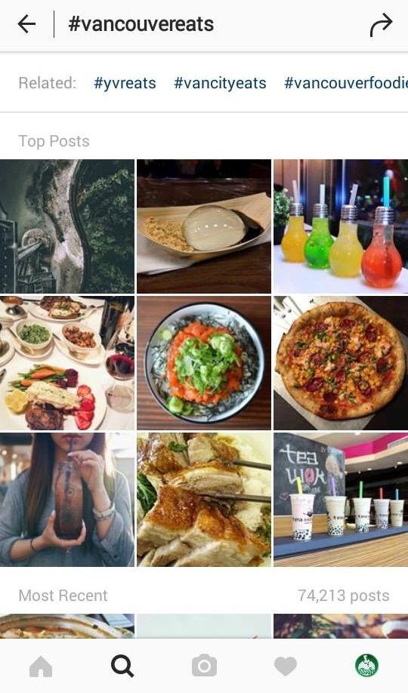
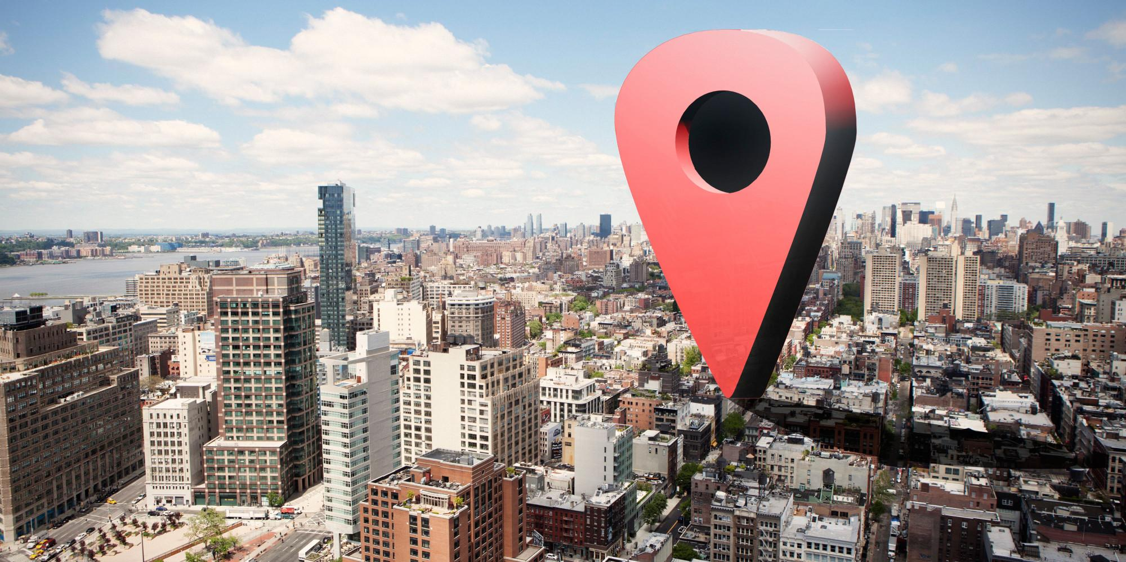
Competitive Advantage
Real time notifications based on your current location
Recommendations based on your social media presence

Slide 19
Business Timeline
May/June 2016
Series A funding
October
Product/market fit determined
500+ trial users
100 businesses interested
August
Alpha Testing
Website launch
February 2017
Beta Launch on iOS

Slide 20
Business Timeline
May~July
Official Launch
iOS and Android
10,000 users
May
100,000 users
Expansion into US
December
250,000+ users
January 2018
50,000 users
Series B funding
Expansion to Toronto, Montreal, and Calgary
Notes:
B

Slide 21
Business Timeline
May, 2019
1 million + users
Worldwide launch
Breakeven Point
October
2.5 million + users
Expansion to shopping, other attractions
Addition of other possible features
Notes:
B

Slide 22
Revenue Model
Paid business page
User Data

Slide 23
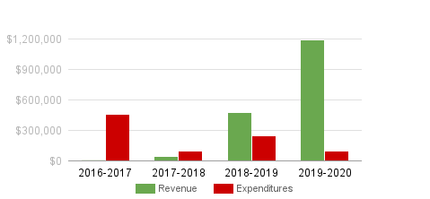
Projected Revenue
(Fiscal year start in May)
Notes:
M

Slide 24

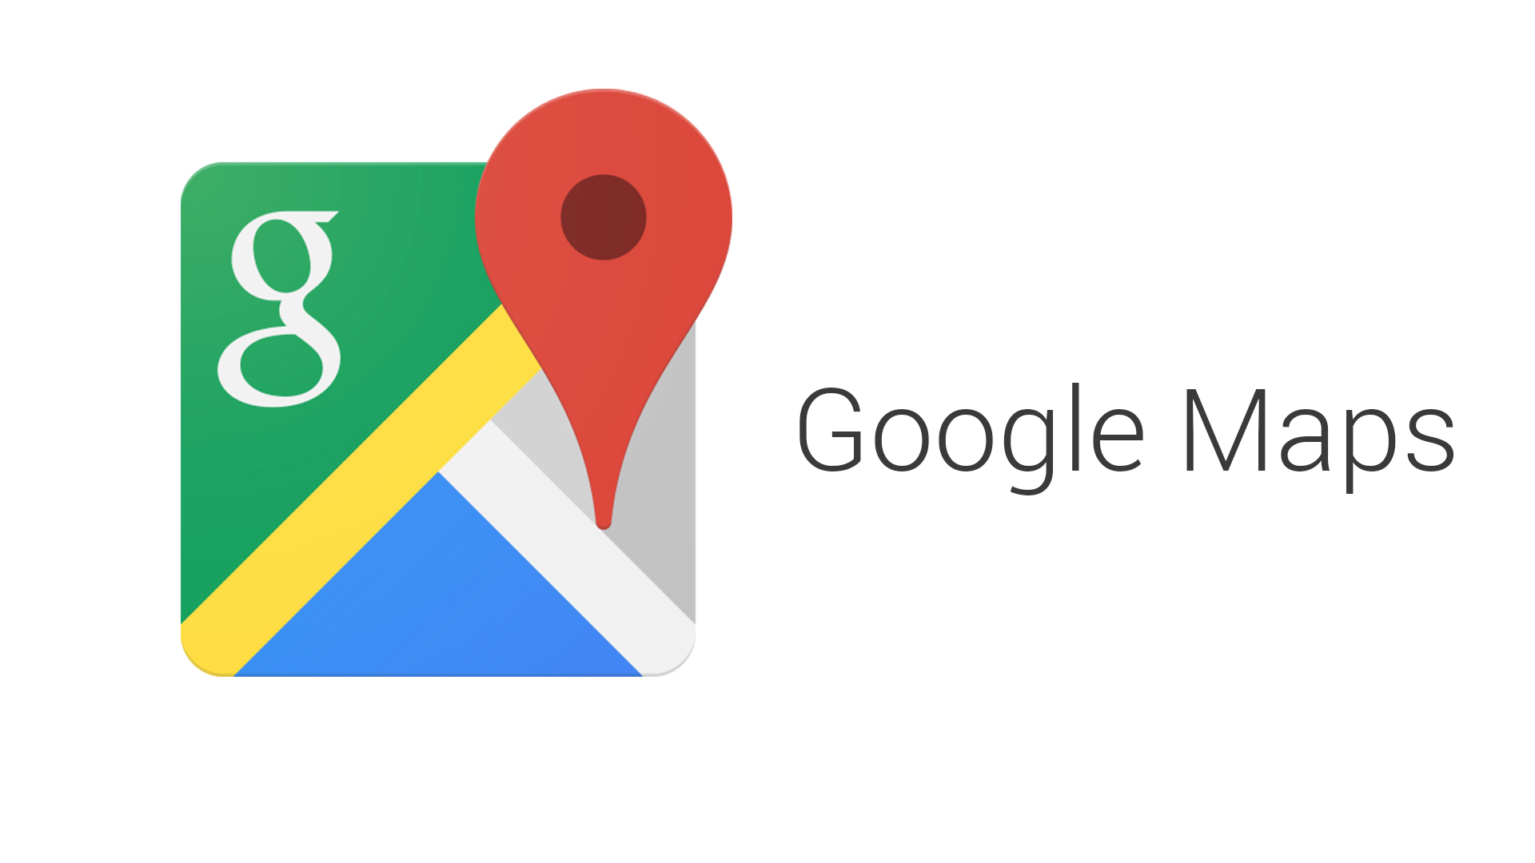


Possible Partnerships

Slide 25
Startup Expenses
(until official launch)
App Development (iOS & Android) | $275,000
Marketing | $100,000
Total | $375,000

Slide 26
Like, Discover, Dine

Slide 27
Any Questions?
Appendix
Revenue Model
Startup Expenses
Business Timeline
Competition Analysis
Target Markets
Customer Validation
The Problem
Marketing Strategy

Slide 28
Appendix
Instagram Data Usage and Privacy Policy
Yelp’s Growth vs Doko Predicted Growth
Detailed Breakdown of Costs
APP UI/UX
App Development Costs
Survey Results

Slide 29
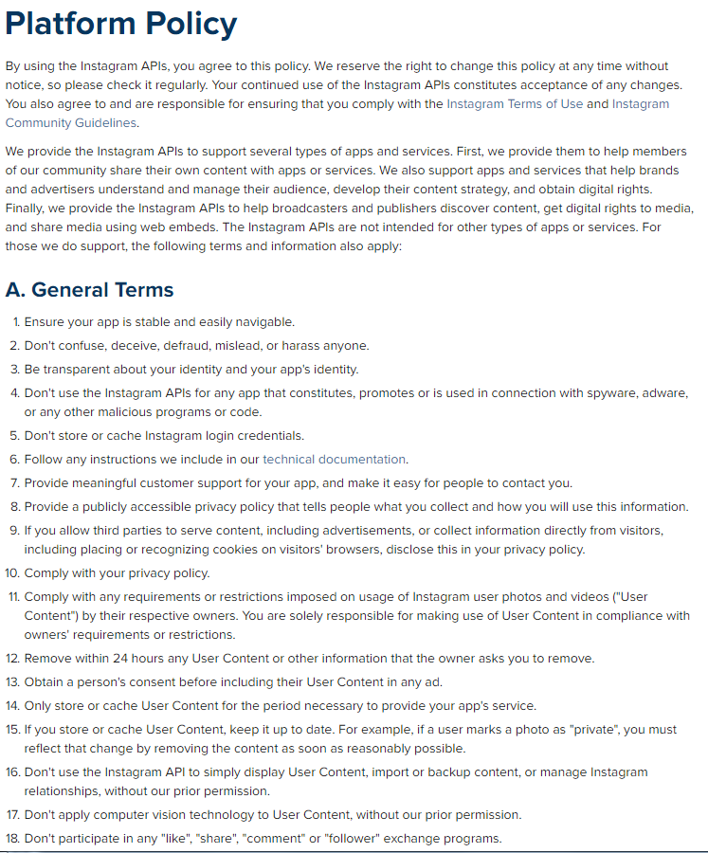
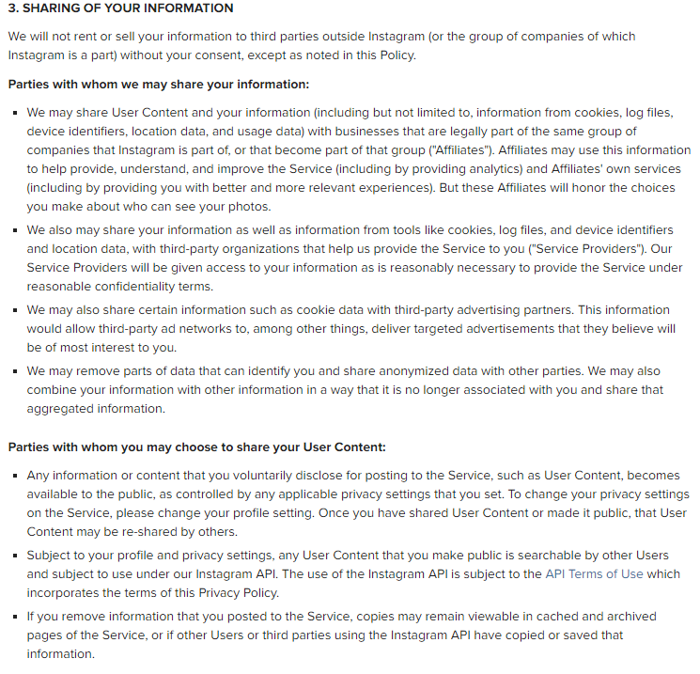
Appendix A: Instagram Data Usage and Privacy Policy

Slide 30
Appendix B: Detailed breakdown of costs
App Development | $275,000 | 500 hours design 3000 hours (mobile backend/BaaS) Integration with 3rd party services Advanced Filters Map View Detailed Property View UI/UX Comprehensive backend with multiple database types
Marketing - 18 months | $125,000 | Social Media - $4000/ month = $72,000 Instagram sponsored ads $6.58 CPM Influencer “takeover” Pay influencer to post Tag Sticker - $1050 for 200,000 Gift Card Giveaway Menu Scramble

Slide 31

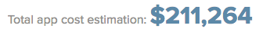
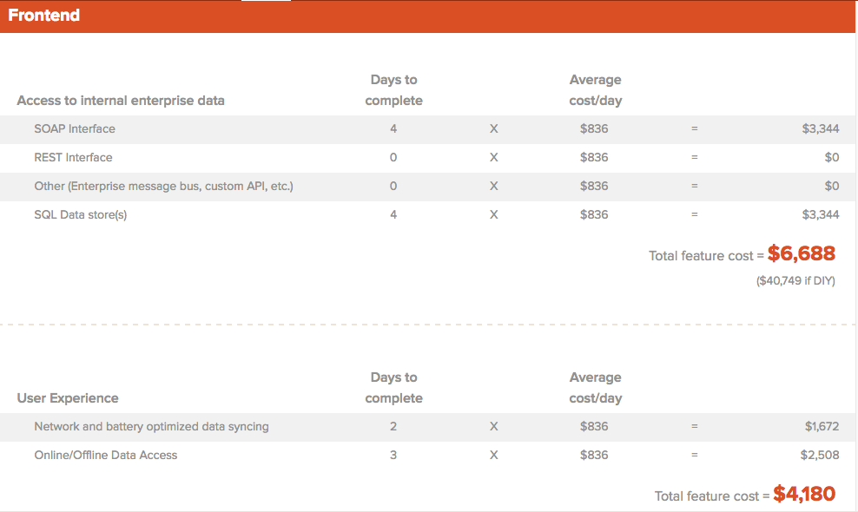
Appendix C: App Development Costs

Slide 32
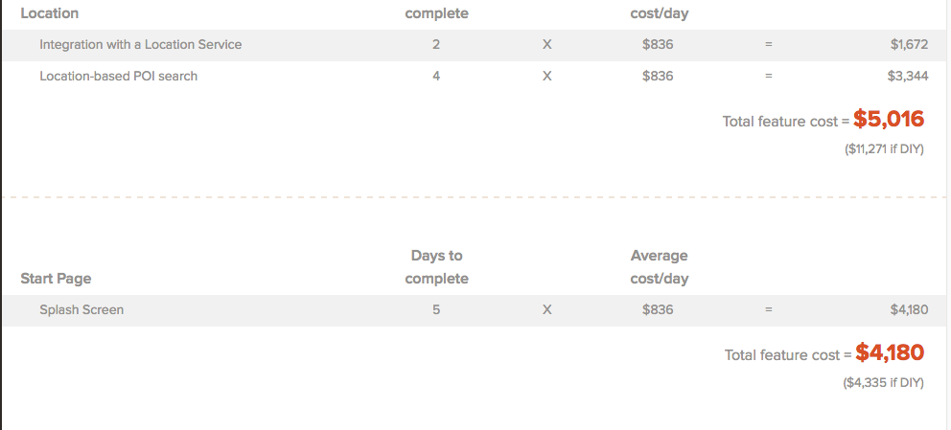

Slide 33
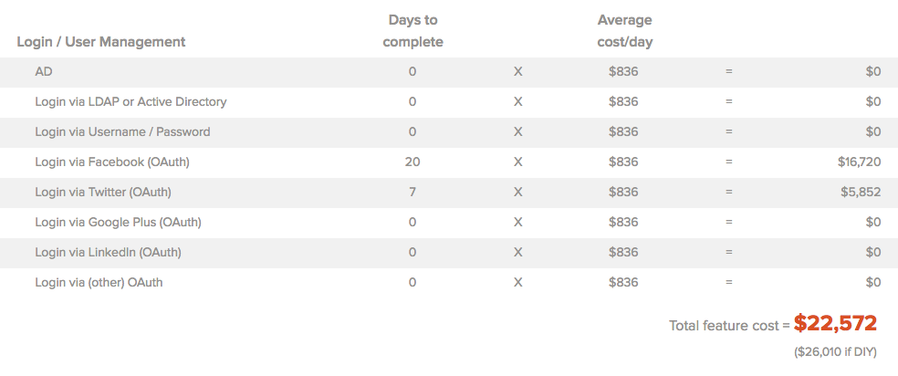

Slide 34
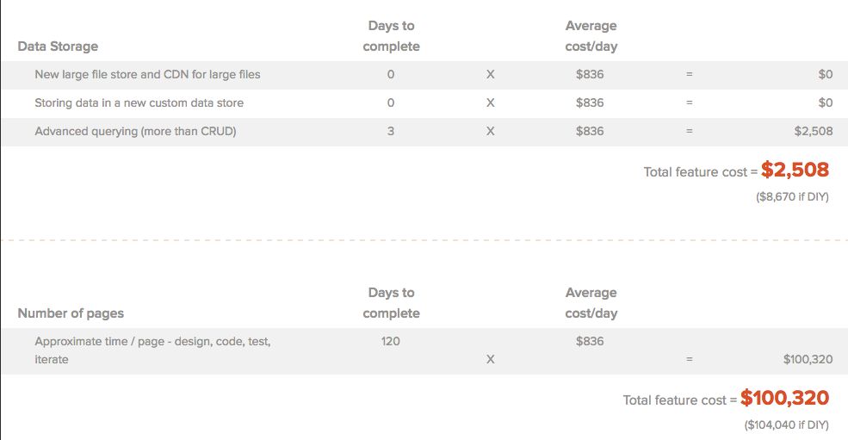

Slide 35
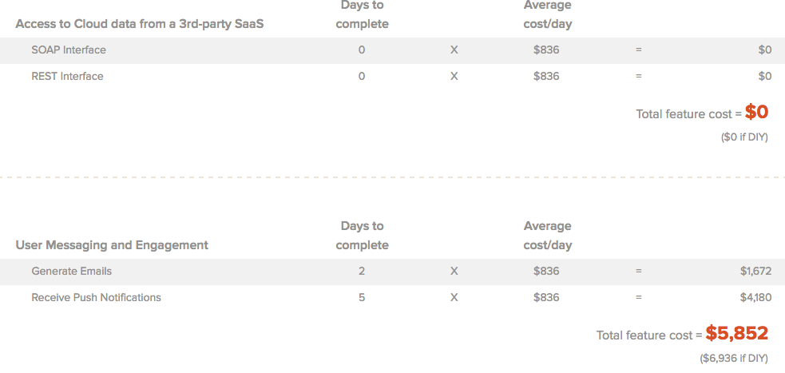

Slide 36
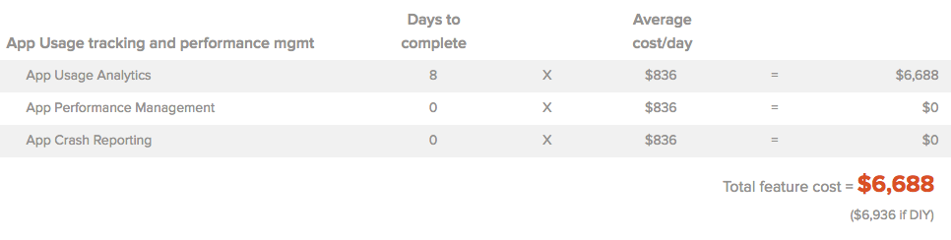
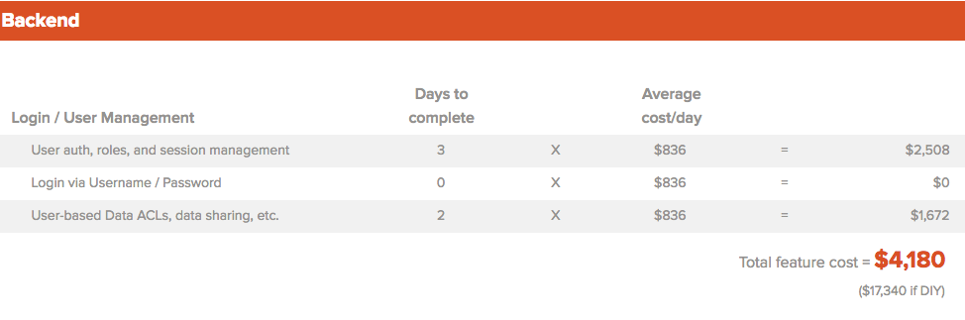

Slide 37
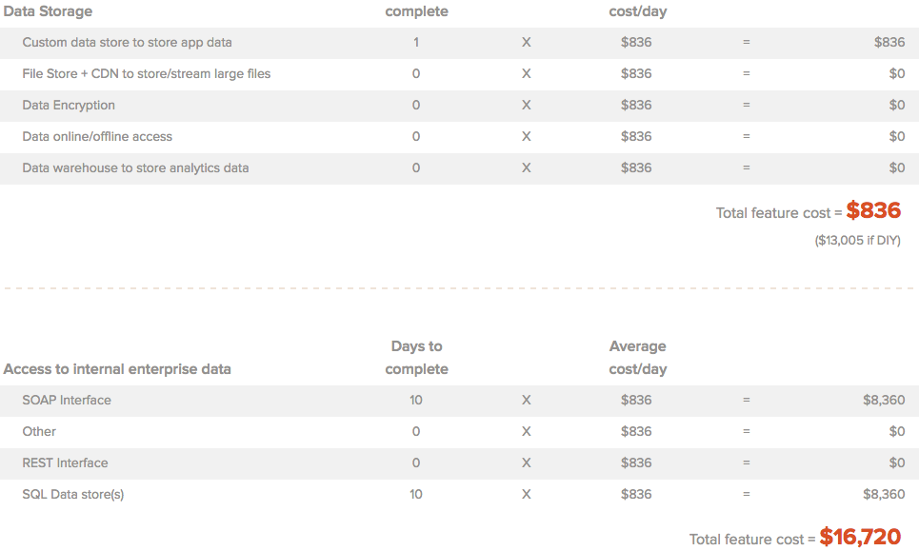

Slide 38
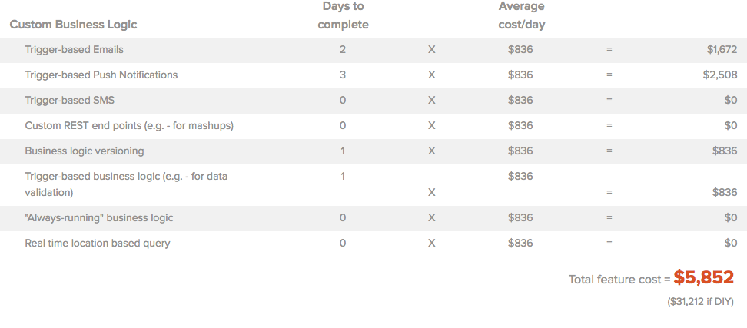

Slide 39
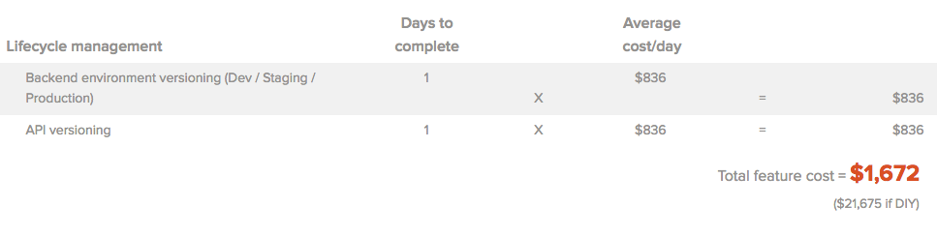

Slide 40
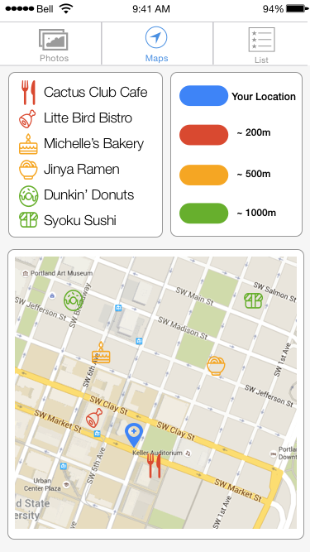
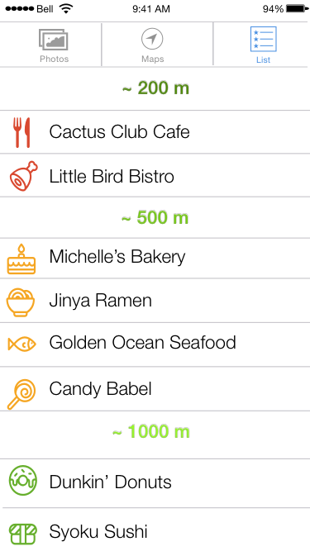

Slide 41
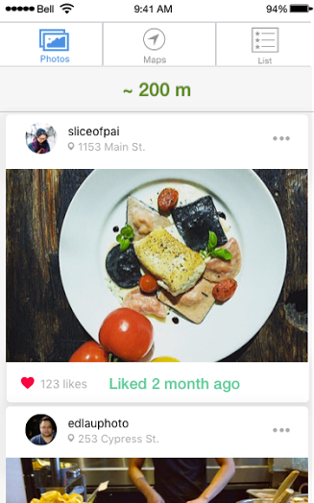

Slide 42
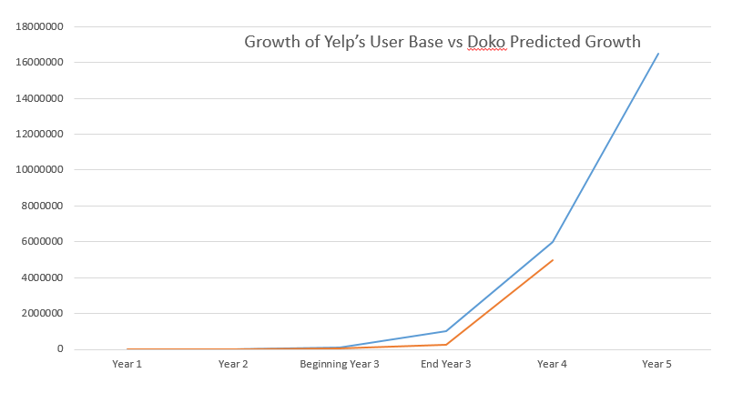
Appendix D: Growth Pattern of Yelp

Slide 43
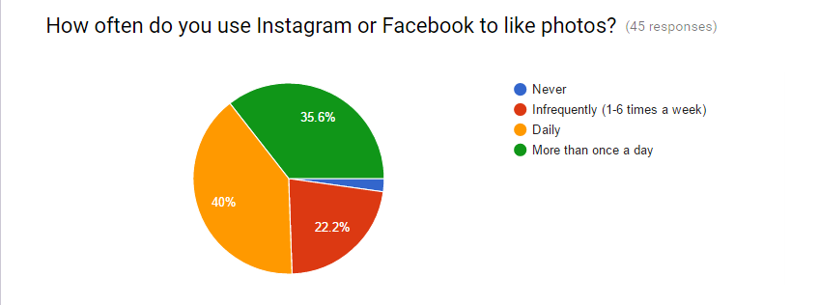
(49 responses)
Notes:
B

Slide 44
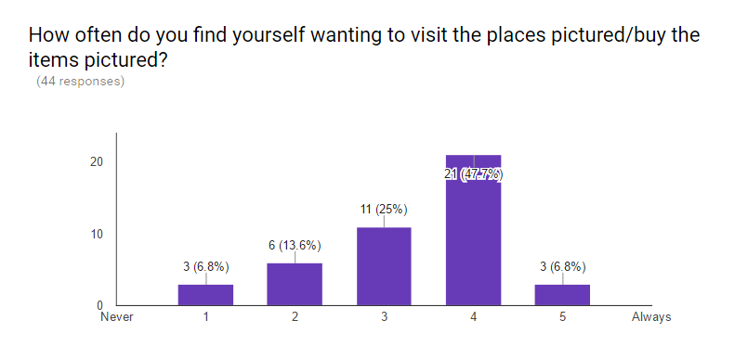
(468 responses)
(47.7%)
(25%)
(13.6%)
(6.8%)
(6.8%)
Notes:
B

Slide 45
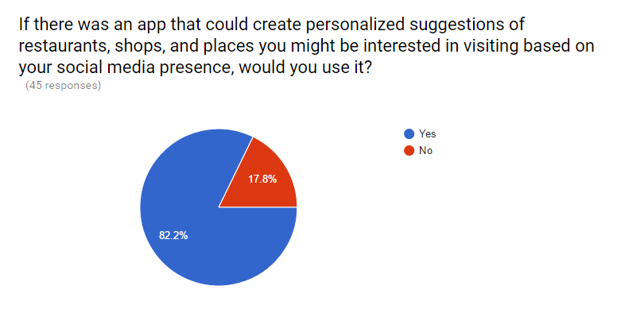
(49 responses)
Notes:
B

Slide 46
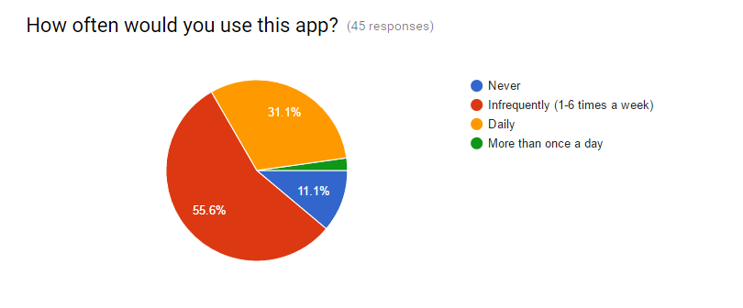
(49 responses)
Notes:
B

